Slide 1

Let's sleep on it
Senior Design Project by: Katie Canedo, Alexis Haley, Aveisha Maharaj, Marko Vukasinovic, and Kayla Mastin
Weekly Update 10/27

Slide 2


General Updates
Website!!
ElectroSense Project
Meeting with Ed on 10/31 @5 pm !!

Slide 3
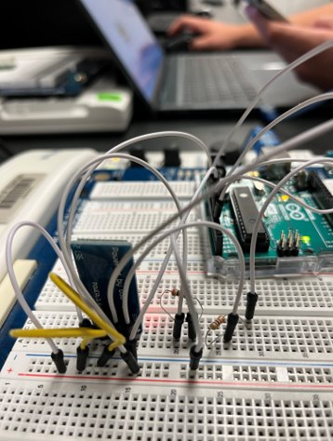
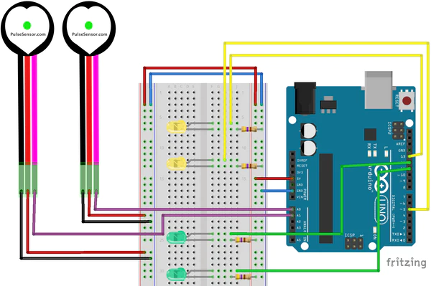
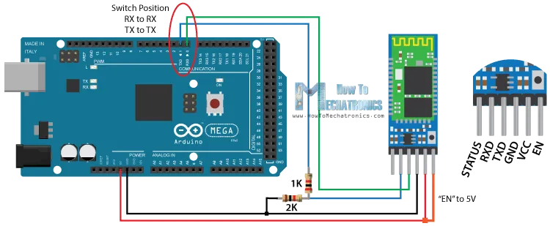
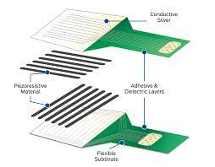
Hardware Update
Ordered breadboard and circuit kit
Received ✔
Heart Sensor
Built ✔
Tested ✔
Modeled layout
Test In Mattress
Pressure Mapping
Modeled layout (in progress)
Building
Testing
Bed Alarm (new sensor)
Building
Testing
Bluetooth Connection
Notes:
The last image shows the piezoresistance material, adhesive dielectric layers for the pressure scan

Slide 4

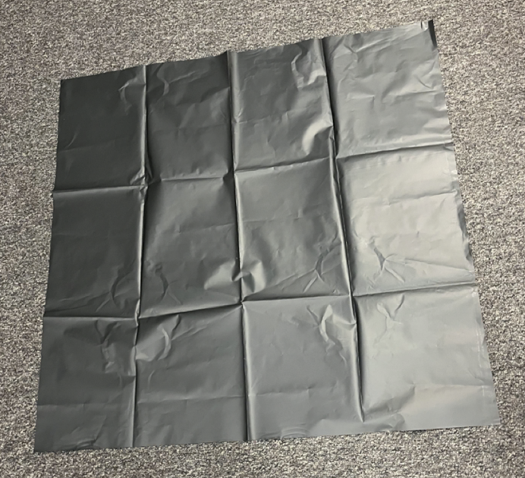
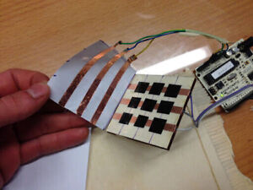
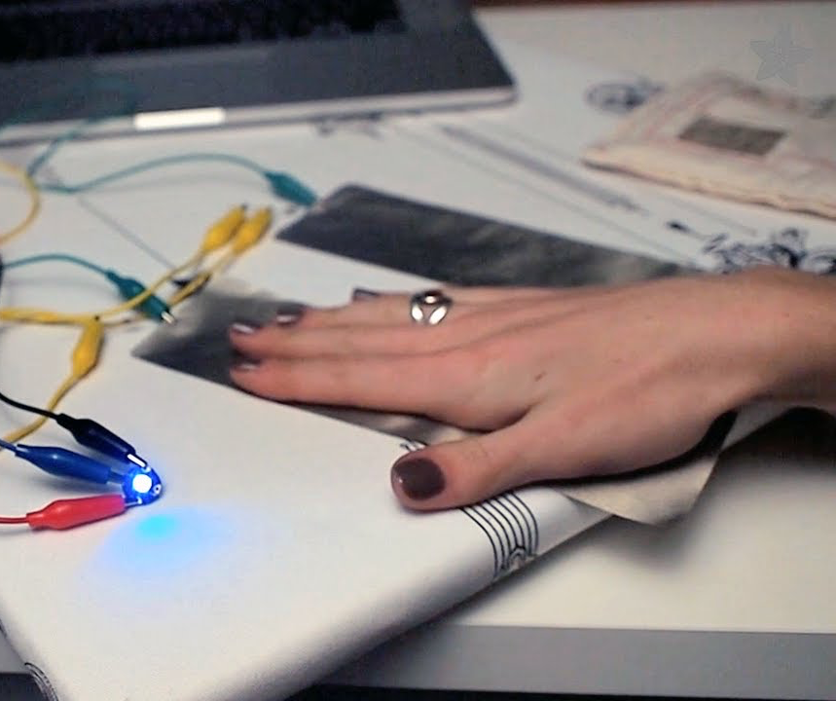
Sensors
Body Pressure Sensor
Sheets are large enough to cover mattress
Add strips of copper on underside
Connect to wiring at the base, then to Arduino
Heart Rate Sensor
Modeled after treadmill
Use conductive fabric joined with 2-4 pulse sensors
Still researching

Slide 5
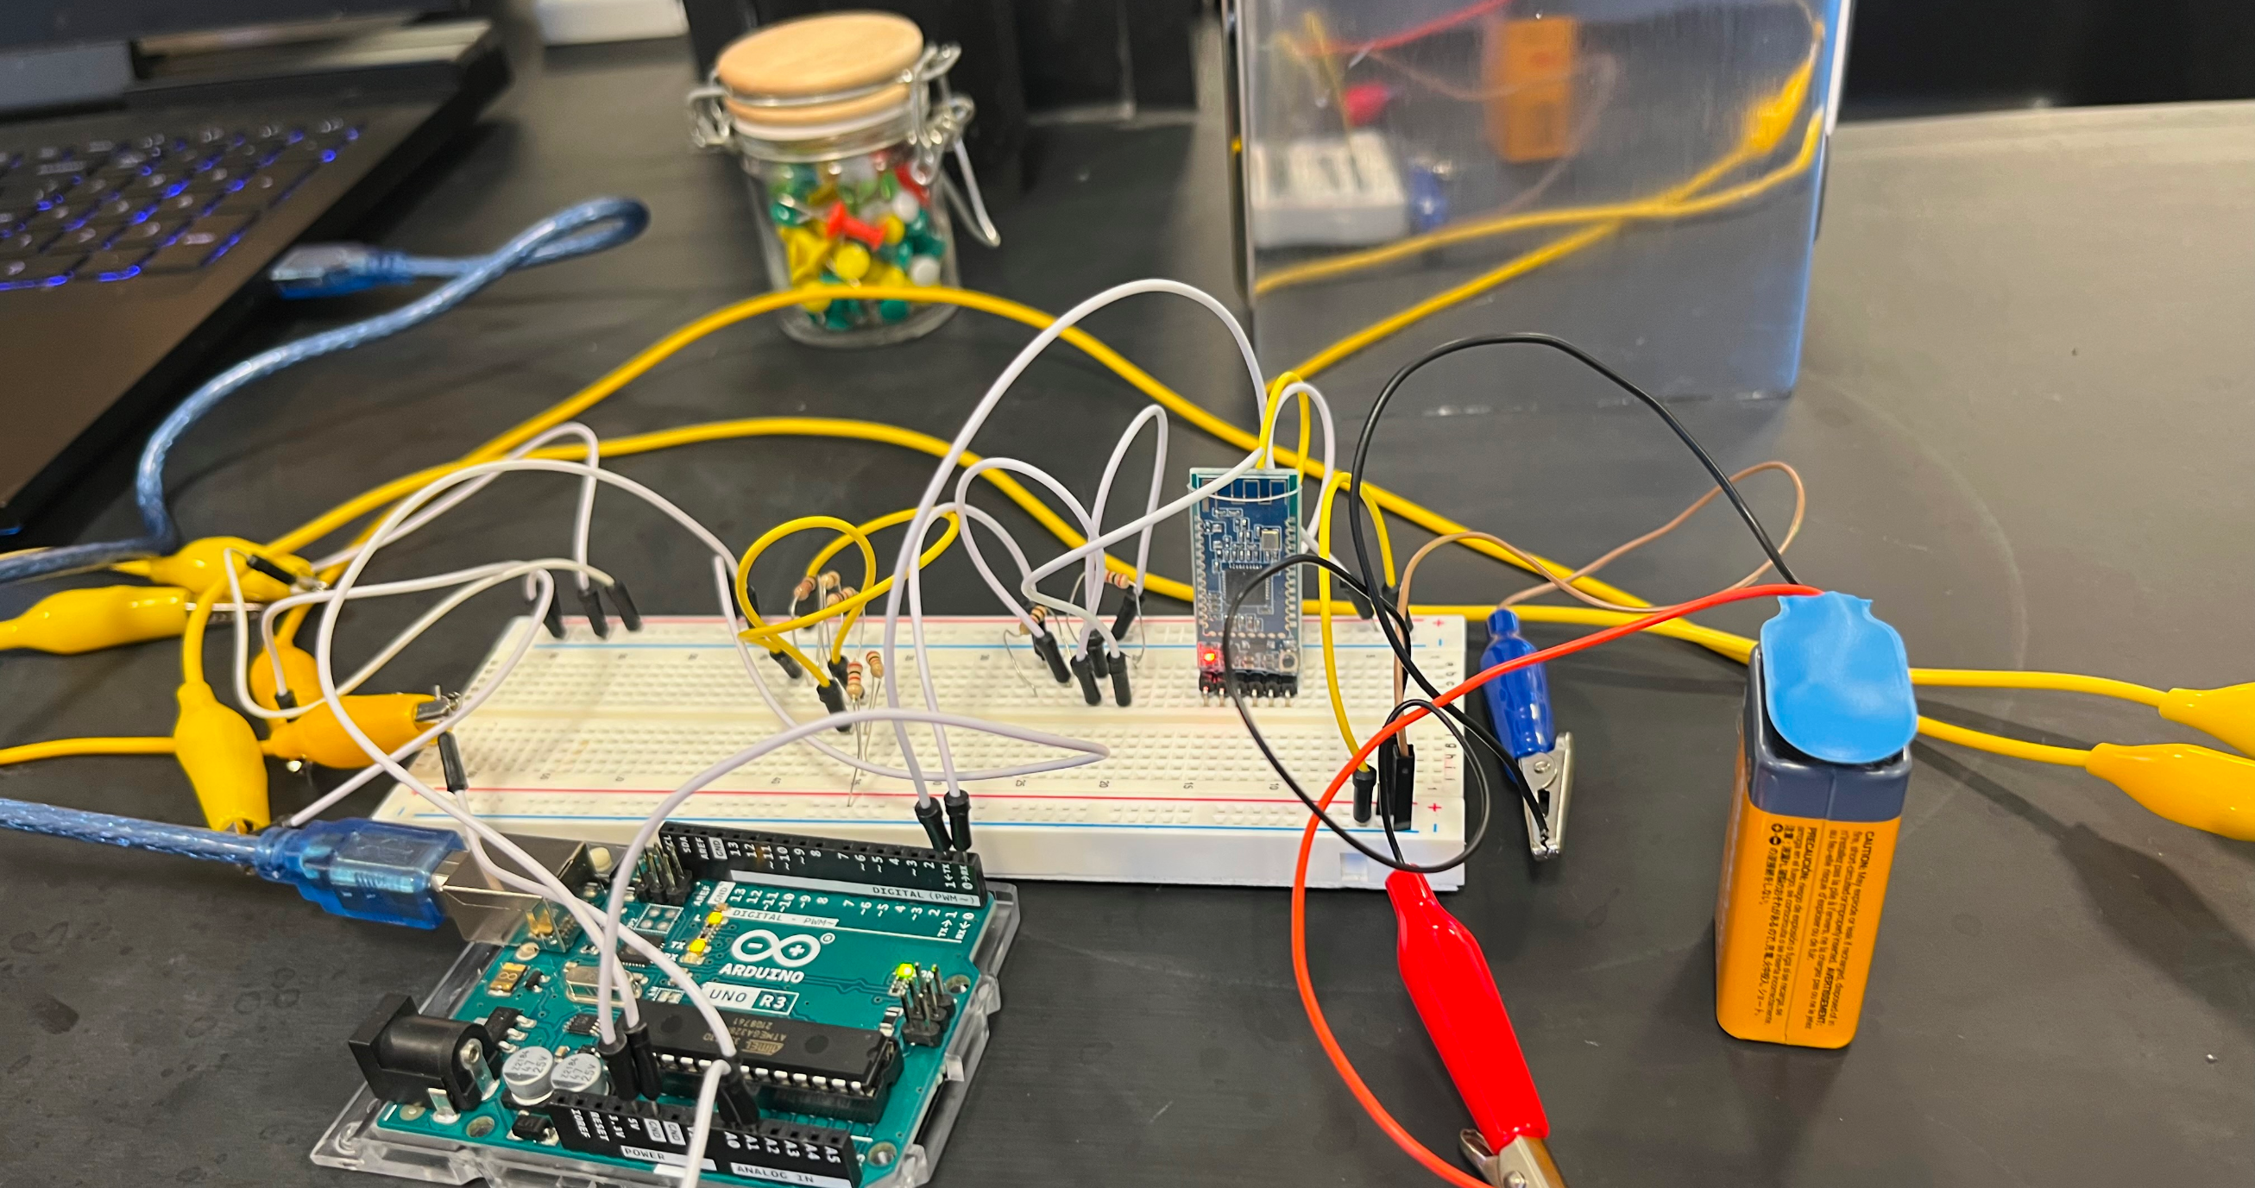

Slide 6
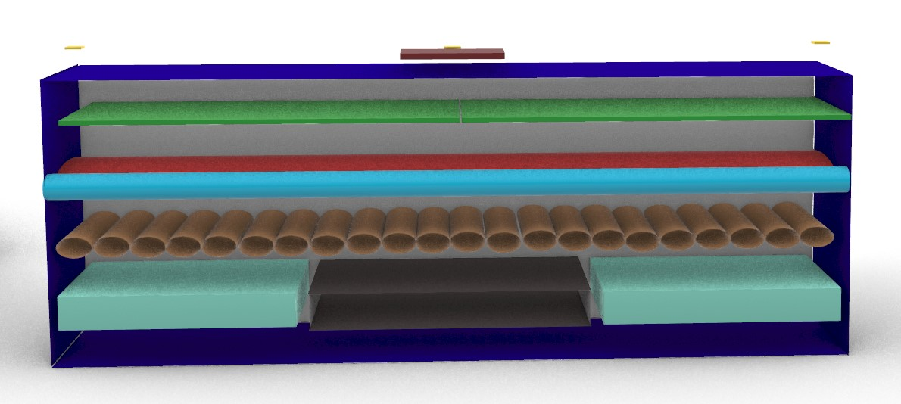
Even Better Model
Temperature Sensor
Pressure Pads
Heart Rate/ Pulse Ox
Layers
- Foam on the bottom surrounding 3D printed compartment
- compression pumps on top as extra layer
- heating pad / cooling gel foam on above pumps
- pressure mapping pads just below top mattress exterior (-50 to 150°F)
- temperature / heart rate sensor either right below top layer or on top of mattress (-58 to 185°F)
Mattress Exterior
Heating/Cooling Elements
3D Printed Compartment for Circuitry
Pumps
(Massage, Bed Sores, Clots)
Foam
** Alarm will be connected in app based on pressure, and on metal bed frame if we have time **

Slide 7
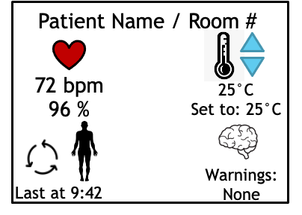

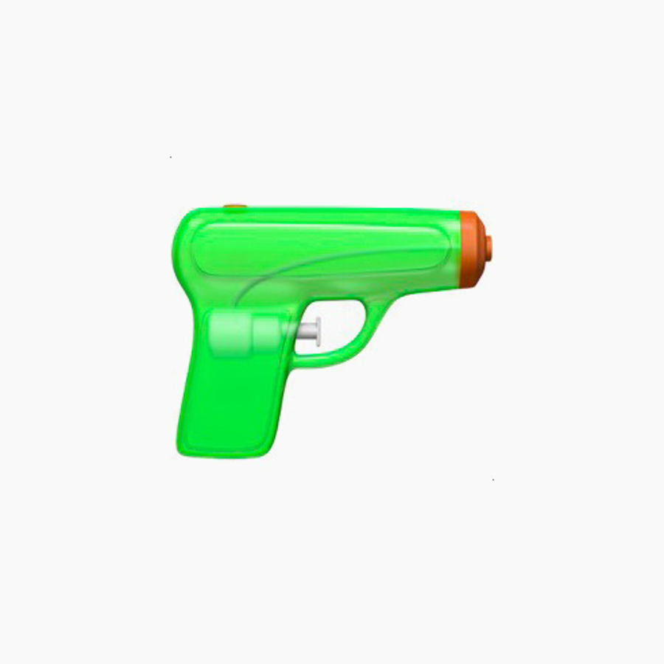
Software
Adding Live Data
iPad and iPhone compatible
Notes:
marko

Slide 8
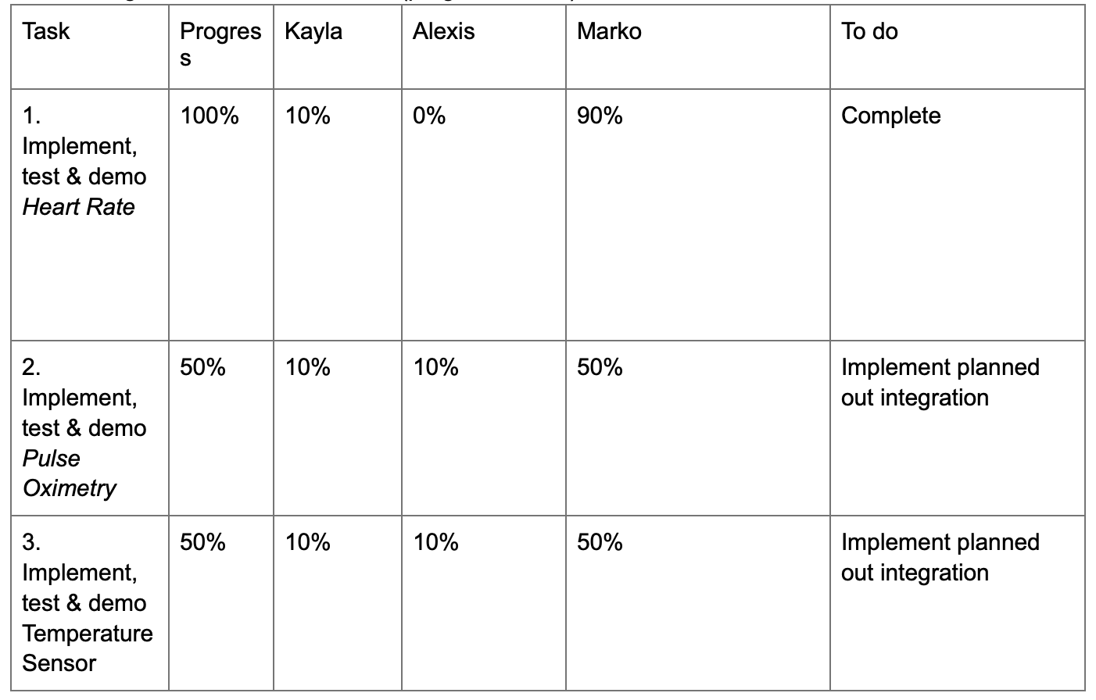
Milestones

Slide 9
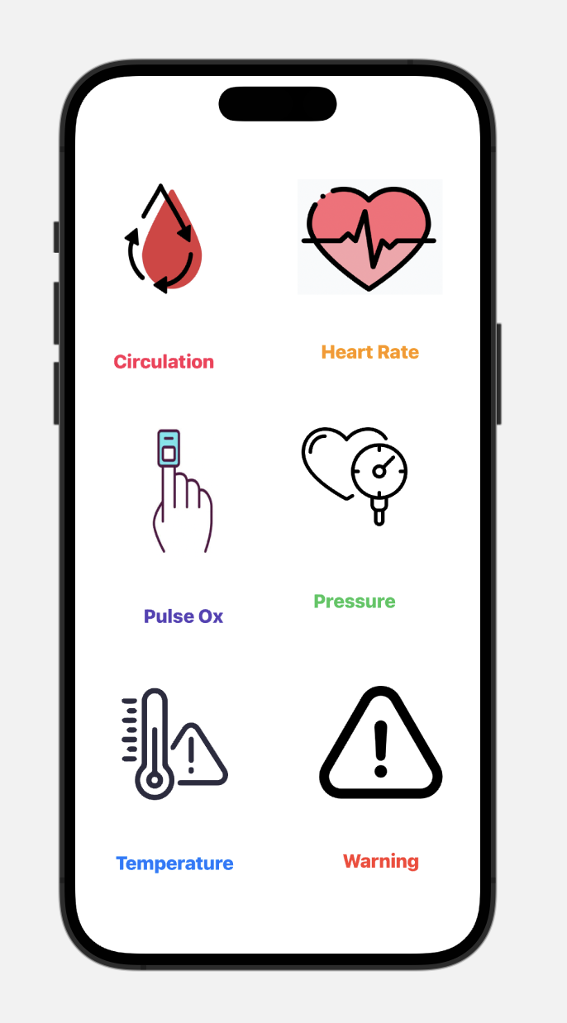
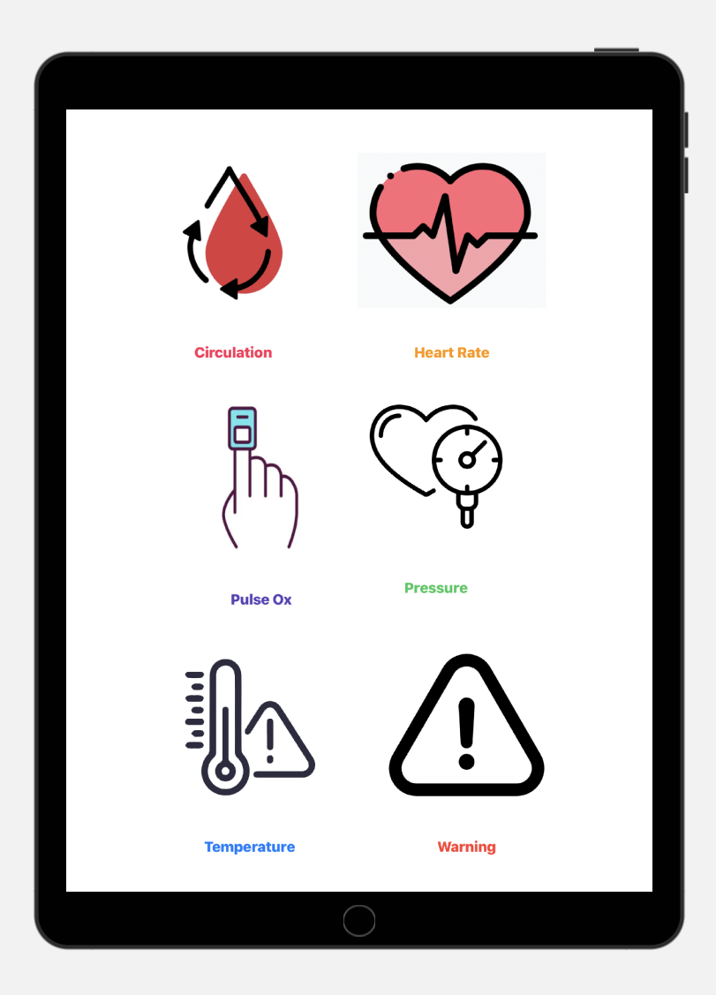
iPhone
iPad

Slide 10


Budget & Estimated Spending
Total Budget Used: $212.09
We are planning to purchase:
Conductive Fabric - $20
Metal Wiring - $15
Bed Alarm Sensor - $15

Slide 11



Next Steps
Next Team Meeting Monday at 5 pm
Meet Ed Virtually
Build heart rate sensor model
Bluetooth circuit connected to app
Body Pressure Model
Hardware Building Thursday 9am and Friday 11am
Notes:
Alexis

Slide 12
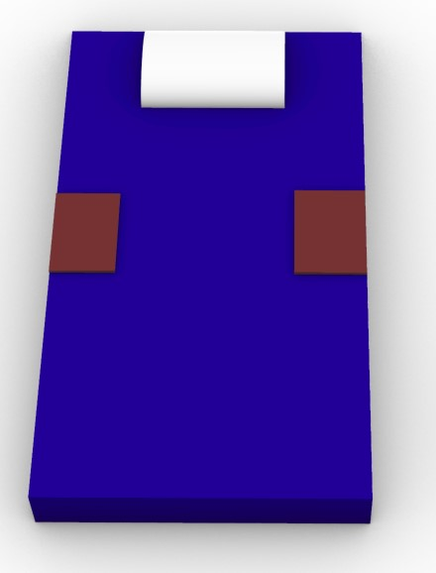
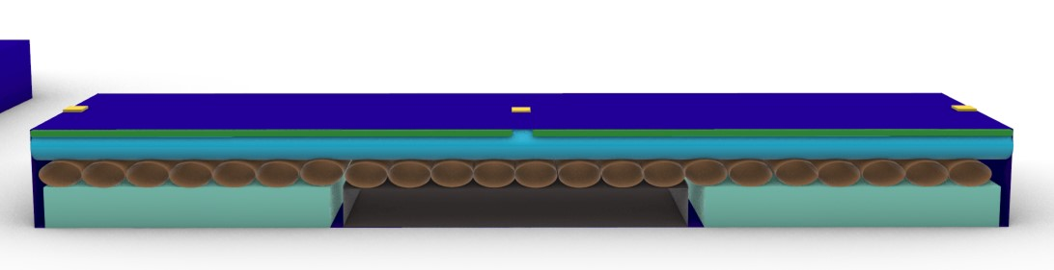
Better Model
Pillow
Temperature Sensor
Pressure Pads
Mattress Exterior
Foam
3D Printed Compartment for Circuitry
Pumps
(Massage, Bed Sores, Clots)
Heating/Cooling Elements
Heart Rate/ Pulse Ox
** Alarm will be connected in app based on pressure, and on metal bed frame if we have time **

Slide 13
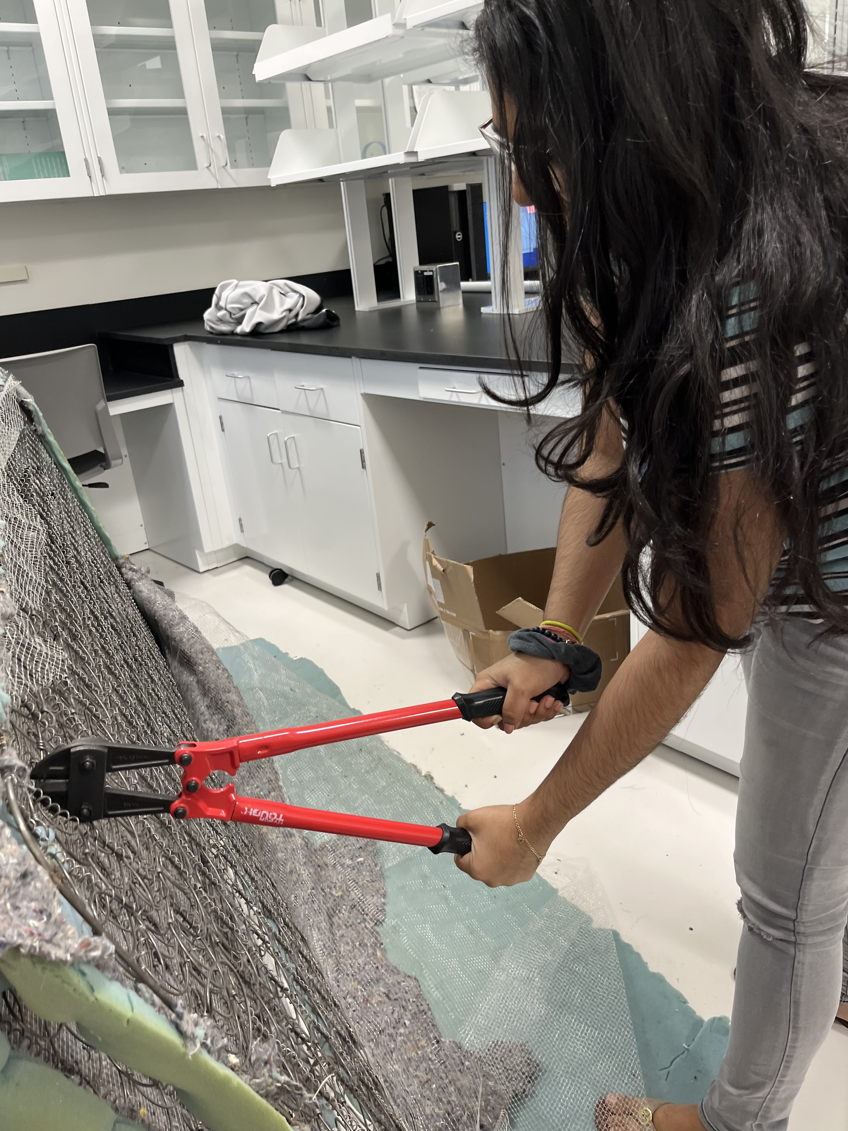
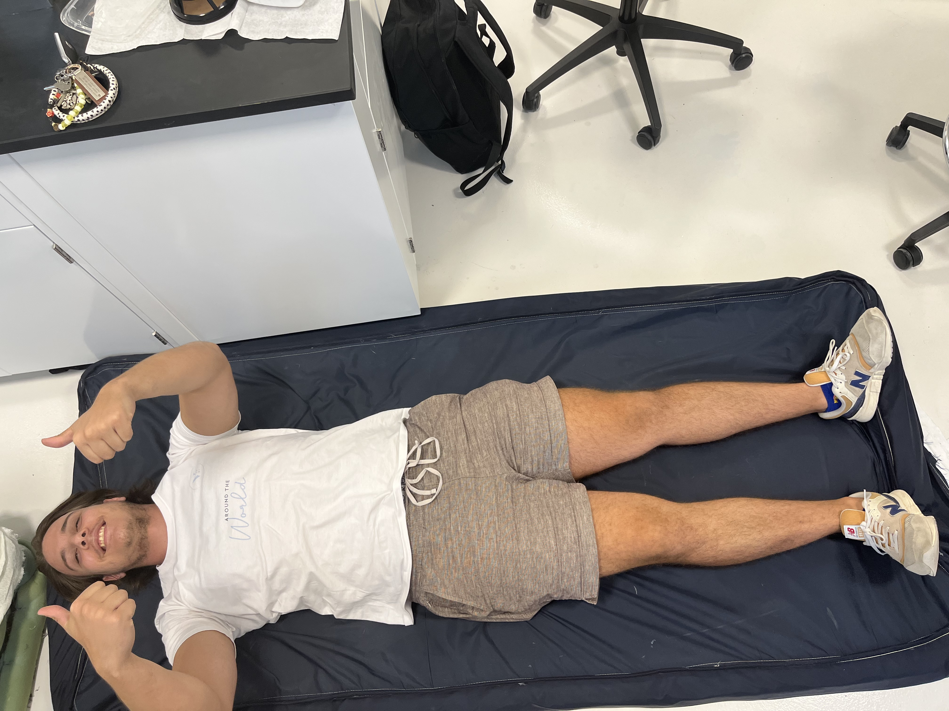
Hardware
Notes:
katie

Slide 14
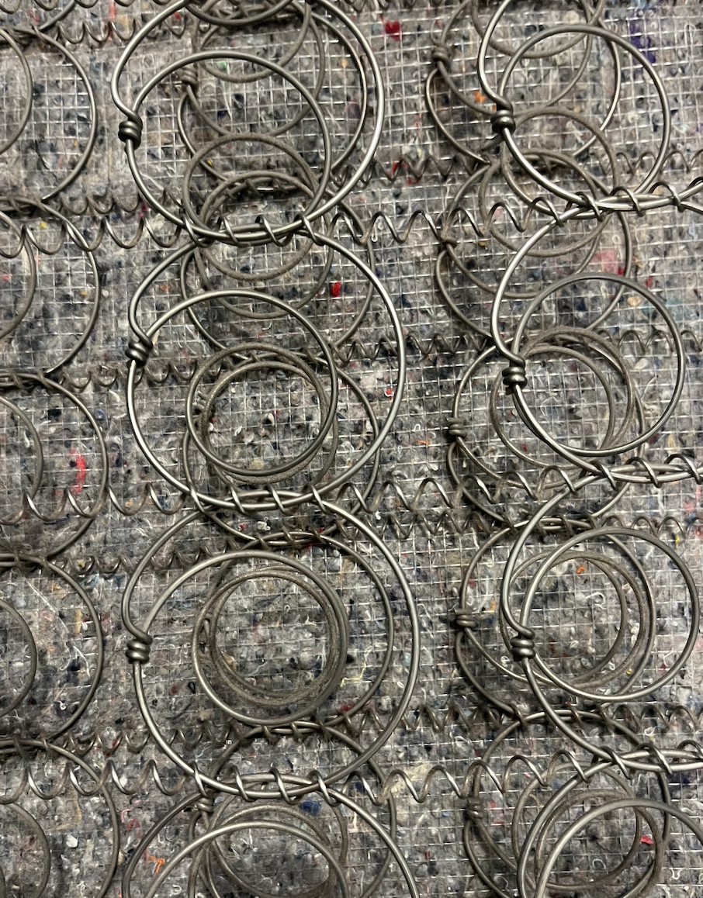
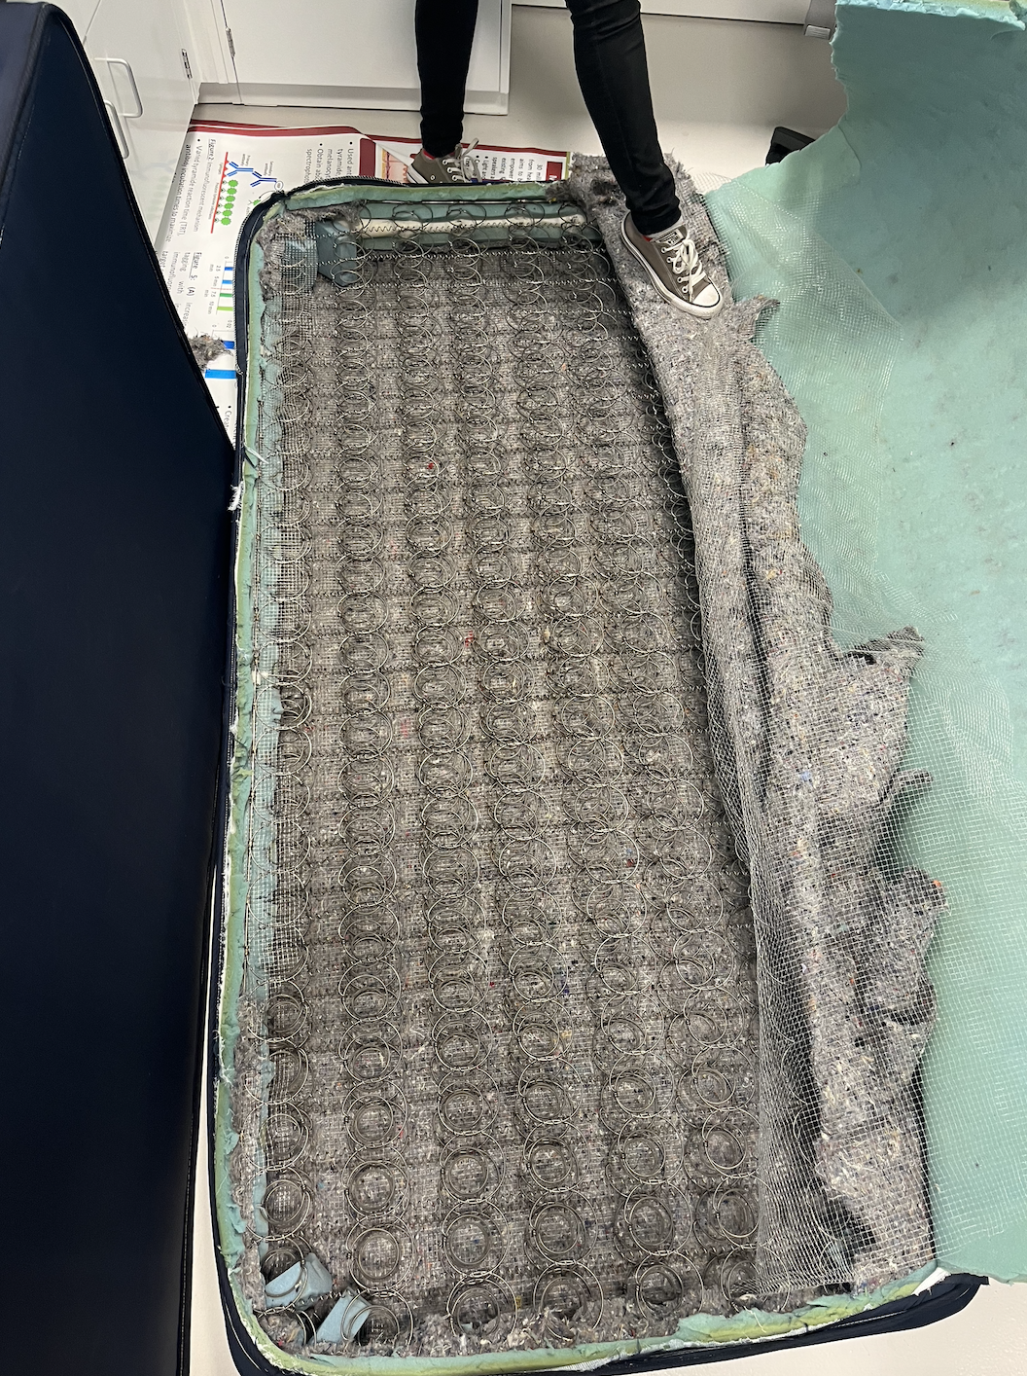
Hardware
Removed wire inside FIT mattress
Need wire cutters
Notes:
aveisha

Slide 15
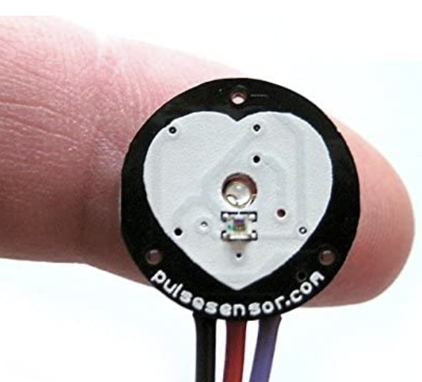
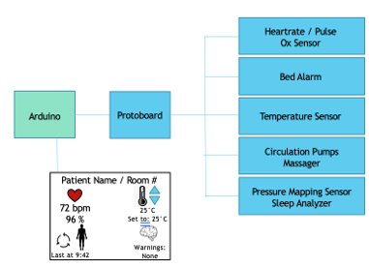
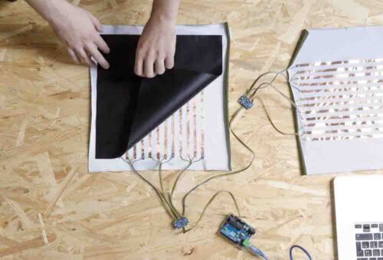
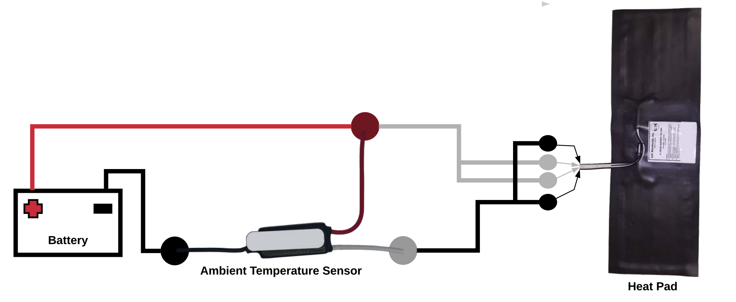
Confirmed Circuits
Heartbeat / Pulse Ox Sensor
Pad Sensor
create our own pad sensor composed of multiple single sensors
Pressure Mapping
Two large pressure mapping sensors
Circulation / Bed Sore Pumps
Adapt a mattress topper to set pumps at timed intervals
Temperature Sensors
Ambient Temperature Sensor for heating
Notes:
aveisha

